Slide 1
Flow-Through Uroflow Device
Group 32
Jordan Nick (presenter), Jodi Small, and Akhil Sundar

Slide 2
Need
Diagnose urinary system issues
50% of men over 40
Diseases
Bladder outlet obstruction
Low bladder pressure
Enlarged prostate

Slide 3
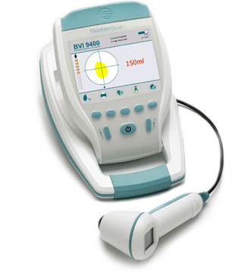
Current Technology
Expensive
Excessive clean up
Frequent maintenance
Miscalculation
Low flow data

Slide 4
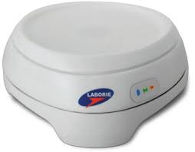
Client’s Technology – Urocap IV
Battery powered
Bluetooth enabled
Meets volume and flow rate specifications

Slide 5
Scope
The purpose of this project is to create a flow-through uroflow system that measures the volume of urine and calculates flow rate in real-time.

Slide 6
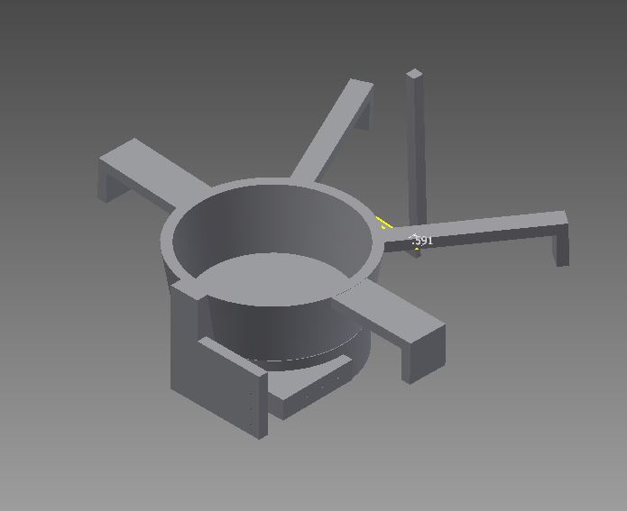
Mechanical Design
Assembly

Slide 7
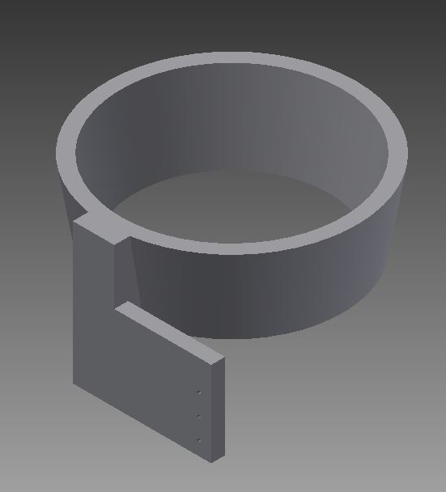
Mechanical Design
Bowl
Fits inside standard toilet
Protrusion for hinge and barrier for force plate
Top radius 9 cm, bottom radius 8 cm
Smallest standard toilet radius – 10.3 cm

Slide 8
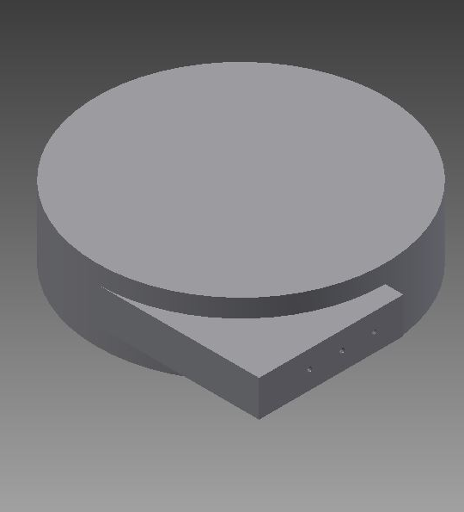
Mechanical Design
Bottom Disk
Houses load cell, circuit board, and Bluetooth communication
Details of inside outside of scope
Protrusion to attach to hinge

Slide 9
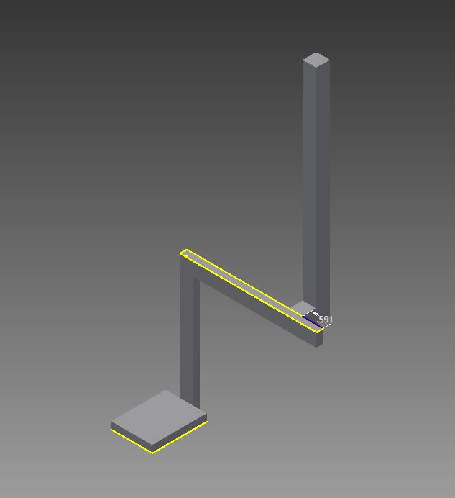
Mechanical Design
Pivot Handle
Arm used to release bottom disk
Arm extends out of toilet
Positioned in back of toilet to minimize interference with patient
Locked in place by magnets

Slide 10
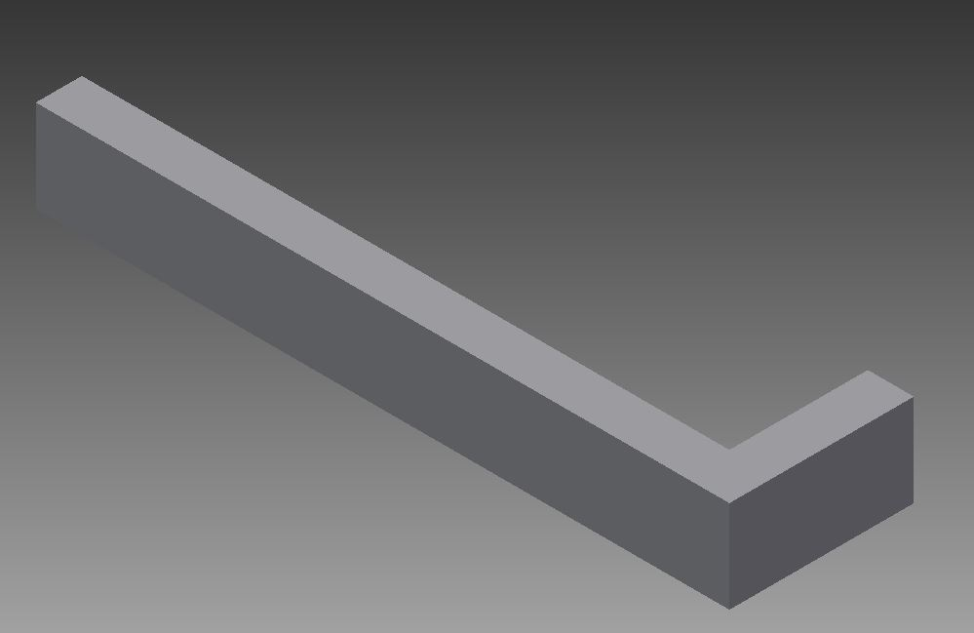
Mechanical Design
Attaching Arms
Attach device to rim of toilet
Two types of arms
One set on right and left
One set in back

Slide 11
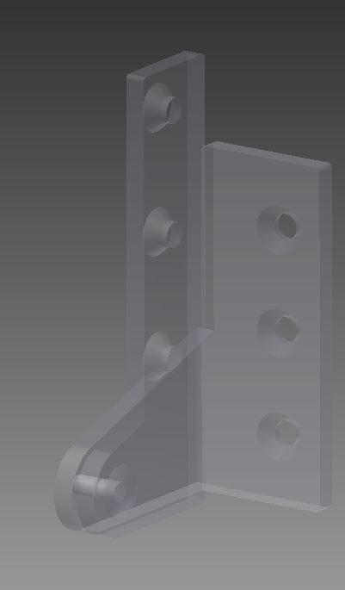
Mechanical Design
Hinge
Allows release of bottom disk
Can support 2.6 kg

Slide 12
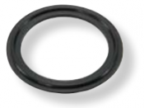
Mechanical Design
Rubber Sealing Ring
Nitrile (Buna-N)
Inexpensive
High abrasion resistance
High resistance to water and oils
Cut from sheets of 0.16 cm thick rubber
Adhesive on one side of rubber

Slide 13
Material Choice
Acrylonitrile Butadiene Stryene (ABS)
Ductile
Strong
Easy to clean
Injection molding
316 stainless steel screws
Resistant to chemical, solvent, and saltwater corrosion

Slide 14
Overview of Discrete Differentiation
Proof of concept using simulated data
Error in volume ±1 mL
Error in flow rate after differentiating ±0.95 mL/s

Slide 15
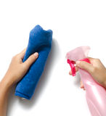
Cleaning
Clean after every use
Fill spray bottle with
Soapy water
Isopropyl alcohol
Mild disinfecting detergent
Spray the device and wipe clean

Slide 16
Manufacturing
4-6 weeks lead time on ABS injection mold
ABS arrives as one continuous piece
Rubber is cut to size and attached
Hinge is attached by screwing into the funnel and bottom disk

Slide 17
Weight Analysis
Piece/Material | Density (kg/cm³) | Volume (cm³) | Total Weight (kg)
ABS (Funnel + Arms + Pivot Handle) | 0.00160 – 0.00180 | 654.71 | 1.05 – 1.18
Hinge | --- | --- | 0.055
Bottom Disk (Force plate + Casing + Additional Wiring) | --- | --- | 0.3
Nitrile (Buna-N) Sealing Ring | 0.0012 – 0.0013 | 1.274 | 0.0015 – 0.0017
Two Magnets | --- | --- | 0.000754
Six Screws | --- | --- | 0.0152
Total Weight: 1.4 – 1.5 kg

Slide 18
Cost Analysis
Piece/Material | Cost per Volume (USD/cm³) | Volume (cm³) | Total Cost (USD)
ABS (Funnel + Arms + Pivot Handle) | --- | --- | Material: $2.792 per part Production: $2.212 per part Tooling: $36,707
Hinge | --- | --- | $11.31
Bottom Disk (Force plate + Casing + Additional Wiring) | --- | --- | $800
Nitrile (Buna-N) Sealing Ring | 4.74 | 1.274 | $6.04
Two Magnets | --- | --- | $0.15
Six Screws | --- | --- | $0.57
Total Cost: $36,707 upfront and $823.07 per part

Slide 19
Design Specifications
Specification | Specific Values | Accomplished?
System’s Size | Depth 0.686-0.762 m and Width <0.508 m | Yes
Target Area | Greater than 350 cm² | Yes, 402 cm²
Water Resistant Machinery | ISO 2281 | Yes
Capture Volume from 0-1 L | Accurate to 2 mL | Yes, accurate to 1 mL
Capture flow from 0-50 mL/s | Accurate to 1 mL/s | Yes, accurate to 0.9472 mL/s
Usable by both men and women | n/a | Yes
Production Cost | Less than $800 | No, ~$145 over budget

Slide 20
Future Work
Give design to Laborie to enhance future generations of Urocap line
Replace magnetic locking system with a mechanical locking system if preferred by Laborie
Simplify design to use less material to reduce costs
Redesign release mechanism

Slide 21
References
"ABS General Purpose." ABS General Purpose. Matbase, n.d. Web.
Chapple, Christopher R., and Claus G. Roehrborn. "A Shifted Paradigm for the Further Understanding, Evaluation, and Treatment of Lower Urinary Tract Symptoms in Men: Focus on the Bladder." European Urology 49.4 (2006): 651-59. Web.
Ciullo, Peter A., and Norman Hewitt. The Rubber Formulary. Norwich, NY: Noyes Publications, 1999. Print.
"Cost Estimator." Injection Molding. Custompart.net, n.d. Web. 30 Nov. 2014.
"Definitions of Resins - Acrylonitrile-Butadiene-Styrene (ABS)." SPI. SPI: The Plastics Industry Trade Association, n.d. Web. 01 Dec. 2014.
Gammie, Andrew, Becky Clarkson, Chris Constantinou, Margot Damaser, Michael Drinnan, Geert Geleijnse, Derek Griffiths, Peter Rosier, Werner Schäfer, and Ron Van Mastrigt. "International Continence Society Guidelines on Urodynamic Equipment Performance." Neurourology and Urodynamics (2014): N/a. Web.
Goping, Ing. "Skype Meeting with Ing Goping." Online interview. 29 Aug. 2014.
Harper, Megan. "FW: Flow Through Uroflow Device - Wash U Senior Design." Message to the author. 13 Nov. 2014. E-mail.
"Innovation for Pelvic Health." Uroflowmeters. Laborie Medical Technologies, n.d. Web. 01 Dec. 2014.
"INTERNATIONAL STANDARD ISO 2281 HOROLOGY." INTERNATIONAL STANDARD ISO 2281 HOROLOGY. International Organization for Standardization, n.d. Web. 01 Dec. 2014.
"KOHLER: Kitchen & Bath, Furniture & Tile, Engines & Generators, Golf & Resort." KOHLER: Kitchen & Bath, Furniture & Tile, Engines & Generators, Golf & Resort. Kohler, n.d. Web. 01 Dec. 2014.
Lenau, Torben. "ABS - Acrylonitrile Butadiene Styrene." ABS - Acrylonitrile Butadiene Styrene. Design InSite, n.d. Web. 01 Dec. 2014.
Marquez, Derek. "Differences Between 18-8, 304, and 316 Stainless Steel - Ask the Expert." Ask the Expert RSS. Portland Bolt & Manufacturing Company, 30 June 2010. Web. 01 Dec. 2014.
(n.d.): n. pag. CAW Health, Safety & Environment Fact Sheet HAZARDOUS SUBSTANCES. Canadian Women's Health Network, Aug. 2011. Web.
"NITRILE RUBBER - COM GRADE BUNA N - NITRILE COMMERCIAL GRADE, .062 X 36.00 X 96.00 ADHESIVE BACKED." NITRILE RUBBER - COM GRADE BUNA N - NITRILE COMMERCIAL GRADE, .062 X 36.00 X 96.00 ADHESIVE BACKED. Rubber Sheet Roll, n.d. Web. 01 Dec. 2014.
"Overlay Door Pivot Hinge." Overlay Door Pivot Hinge. McMaster-Carr, n.d. Web. 01 Dec. 2014.
"Plastic Properties Of Acrylonitrile Butadiene Styrene (ABS)." Acrylonitrile Butadiene Styrene Properties. Dynalab Corp, n.d. Web. 30 Nov. 2014.
Sun, Thomas. "FW: **URGENT, More Questions** Re: FW: Flow Through Uroflow Device - Wash U Senior Design." Message to Andriy Trebin and Stanley Koziol. 25 Nov. 2014. E-mail.
"Super Strong Neodymium Disc Craft Magnets 1/4 X 1/16 Inch N42 (Set of 100)." : Arts And Crafts Adhesives: Amazon.com: Industrial & Scientific. Amazon, n.d. Web. 01 Dec. 2014.
Trebin, Andriy. "RE: FW: Flow Through Uroflow Device - Wash U Senior Design." Message to Stanley Koziol. 24 Nov. 2014. E-mail.
"Type 316 Stainless Steel Flat Head Phillips Machine Screw." McMaster-Carr Type 316 Stainless Steel Flat Head Phillips Machine Screw. McMaster-Carr, n.d. Web. 01 Dec. 2014.
"Uroflowmetry: MedlinePlus Medical Encyclopedia." U.S National Library of Medicine. U.S. National Library of Medicine, n.d. Web. 01 Dec. 2014.

Slide 22
Thank You Questions?

Slide 23
Prototype Demonstration
Group 32
Jordan Nick , Jodi Small, and Akhil Sundar

