Slide 1
Flow-Through Uroflow Device
Group 32
Akhil Sundar (presenter),
Jodi Small, Jordan Nick

Slide 2
Need
Diagnose urinary system issues
50% of men over 40
Diseases
Bladder outlet obstruction
Low bladder pressure
Enlarged prostate

Slide 3
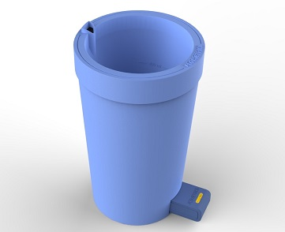
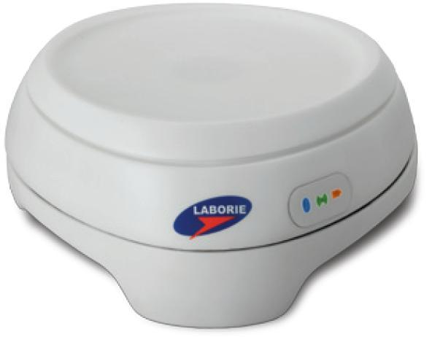
Current Technology
Expensive
Excessive clean up
Frequent maintenance
Miscalculation
Low flow data

Slide 4
Scope
Create a flow-through uroflow system that measures either volume or flow rate and calculates the other in real-time.
Notes:
Flow –through means we want the urine to flow into a toilet, and not have to be transferred from a beaker to a toilet

Slide 5
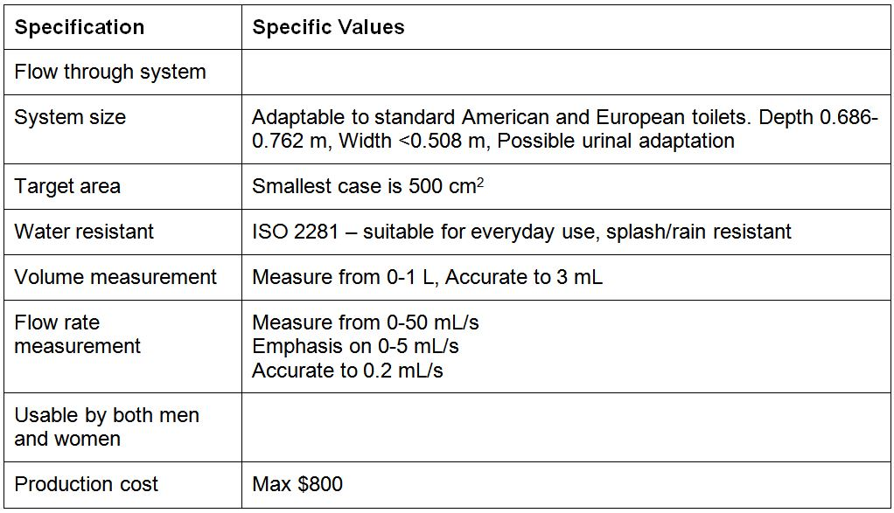
Design Specifications

Slide 6
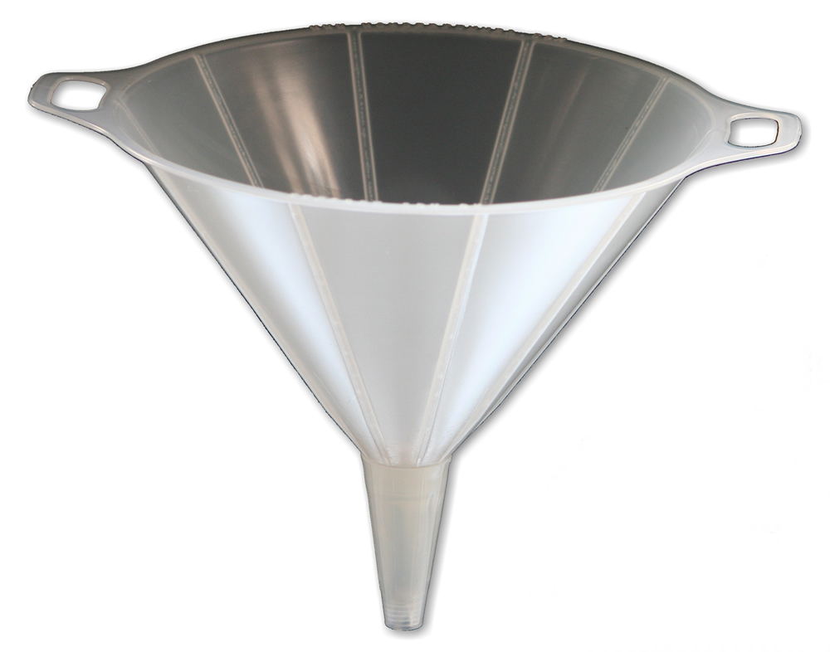
Alternatives: Funnel
Disposable funnel
Proper material
Reusable funnel
Requires cleaning
Releasable bottom
No funnel
Notes:
Flow –through means we want the urine to flow into a toilet, and not have to be transferred from a beaker to a toilet

Slide 7
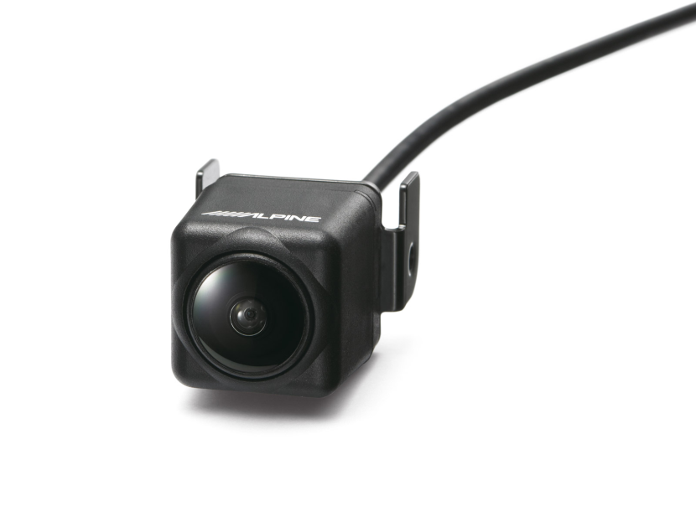
Alternatives: RGB Camera
Separate urine from background
With funnel
Translucent funnel
Measure urine levels
Without funnel
2 cameras
Cross-sectional area and height
Issues: comfort and accuracy
Notes:
Measure urine levels from height and cross sectional area, differentiate to find flow rate.
w/o funnel, calculate volume in discrete periods of time,

Slide 8
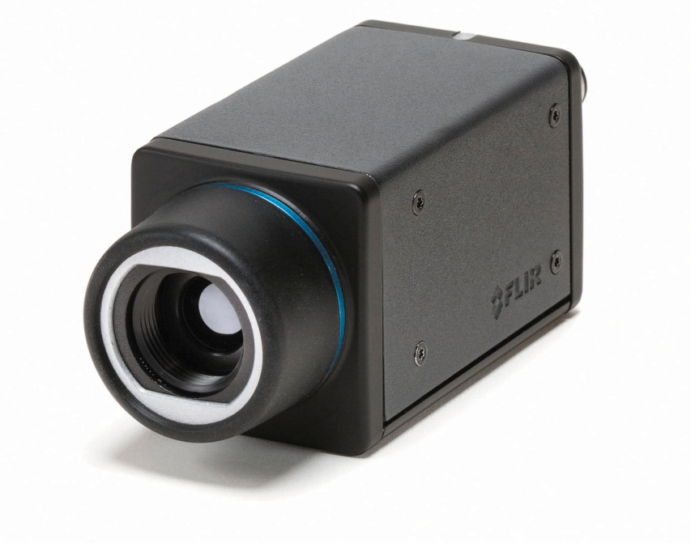
Alternatives: Thermal Imaging
Easy to visualize urine
With funnel
Conduct heat
Without funnel
Similar to RGB
Issues: accuracy and cost

Slide 9
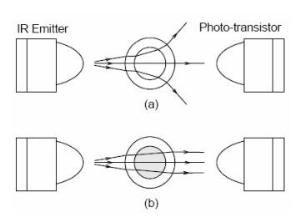
Alternatives: Optical Sensors
Measures flow rate
Uses refractive indexes
Accurate
Requires funnel
Issues
Unsanitary
Space
Figure 1: (a) air disperses light. (b) liquid focuses light
Notes:
Sensors have to be right up against funnel, so disposable is no option. Sensors have to be removed during any cleaning, which is complicated and unsanitary. The column being measured has to be very thin, and creating space is an issue

Slide 10
Alternatives: Ultrasound Imaging
Requires a funnel
Image fluid in funnel
Issues
Air barrier
Unsanitary maintenance

Slide 11
Alternatives: Transmitting Bob
Floating sensor using radar
Can do with or without funnel
Measures volume
Detects urine level
Known funnel/toilet geometry
Issues: cleaning and accuracy
Notes:
Accuracy issues are due to low flow

Slide 12
Alternatives: Force Transducer
Force plate inside toilet
Used in some current devices
Not flow through
High refresh rate
Measure volume
Issues
Splashing if no funnel

Slide 13
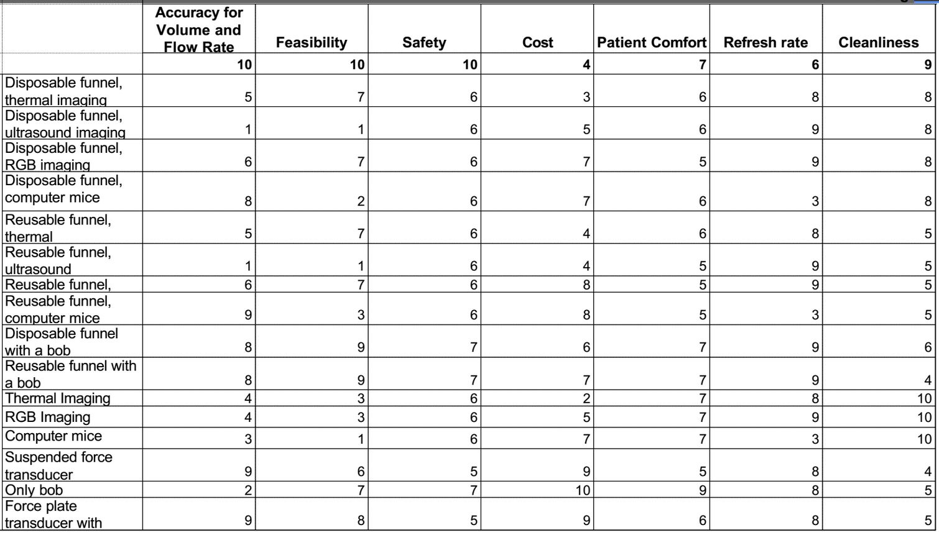

Slide 14
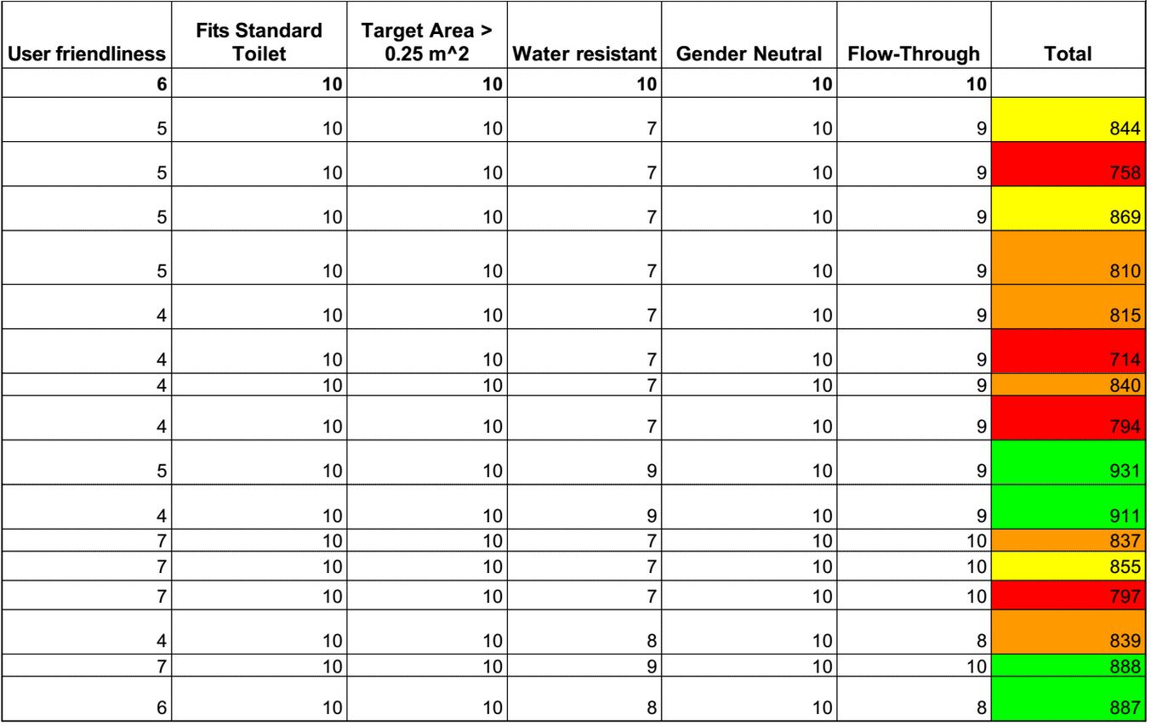

Slide 15
Final Options
Disposable funnel with bob
Reusable funnel with bob
No funnel with bob
Force plate with funnel/basin
Notes:
Decided not to go with bob technology because of cleaning issues, and our client Laborie already has the force plate technology but it is used in a non-flow through environment

Slide 16
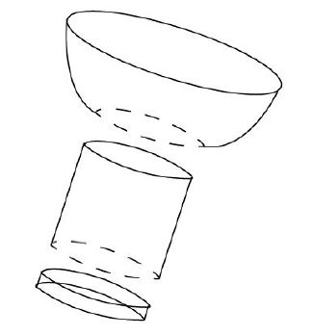
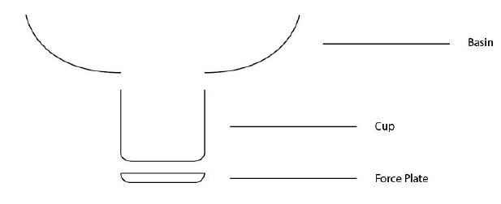
Chosen Design
Reusable basin
Cup with force plate
Releasable bottom
Measures volume
Figure 2: Initial sketches

Slide 17
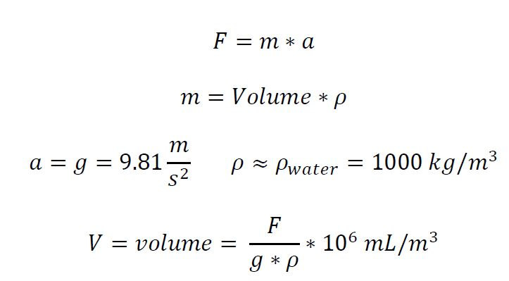
Chosen Design

Slide 18
Chosen Design
Uses current technology
Minimizes splashing
Easy to clean
Can adapt Bluetooth

Slide 19
Design Schedule

Slide 20
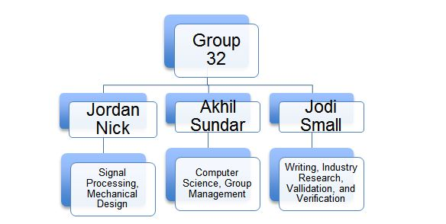
Team Responsibilities

Slide 21
Thank You
Questions?

Slide 22
Figures
1. Nguyen, Nam-Trung, and Thai-Quang Troung. “Flow rate measurement in microfluidics using optical sensors.” 1st international conference on sensing technology, Palmerston North. 2005.

