Slide 1
Flow-Through Uroflow Device
Group 32
Presented by Jodi Small

Slide 2
Background: Diseases
Lower Urinary Tract Symptoms (LUTS)
Affects 90% men between 50-80 years old
Bladder Outlet Obstruction (BOO)
Benign Prostatic Hyperplasia (BPH)
Overactive Bladder (OAB)
Notes:
Say that diagnosing each disease using measuring flow rate and volume can come from our device

Slide 3
Background: Diseases
Bladder Outlet Obstruction (BOO)
Causes
Pelvic Tumors
BPH
Bladder Stones
Symptoms
Low Urine Flow
Frequent Urination
Diagnosis Methods
Measure Flow Rate
Measure Bladder Wall Thickness
Notes:
85% patients with walls >5mm, 37% <5mm

Slide 4
Background: Diseases

Slide 5
Background: Diseases
Benign Prostatic Hyperplasia (BPH)
Periurethral tissue is 2% prostate tissue
Prostatic Infarction
Benign tumors around urethra
85% patients with urinary retention issues + BPH had prostatic infarcts
3% patients with infarcts and BPH but no urinary retention issues

Slide 6
Background: Diseases

Slide 7
Background: Diseases

Slide 8
Background: Diseases
Overactive Bladder (OAB)
16% men and women in US
Cardinal Symptoms
Bladder unexpectedly and frequently releasing urine
> 8x day, 2x night

Slide 9
Existing Technologies
Commercial Products
Urocap IV, spinning disk by Laborie

Slide 10
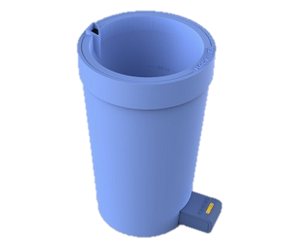
Existing Technologies
Commercial Products
Urocap IV, spinning disk by Laborie
FloRite by Flowmetrica

Slide 11
Existing Technologies
Commercial Products
Urocap IV, spinning disk by Laborie
FloRite by Flowmetrica
BladderScan by Verathon

Slide 12
Existing Technologies
Commercial Products
Urocap IV, spinning disk by Laborie
FloRite by Flowmetrica
BladderScan by Verathon
Various products by Medical Measurement Systems

Slide 13
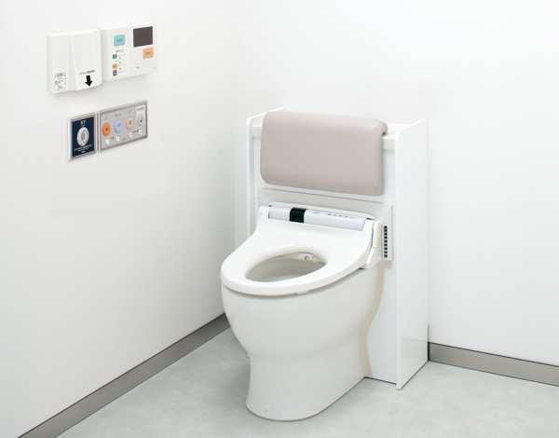
Existing Technologies
Commercial Products
Urocap IV, spinning disk by Laborie
FloRite by Flowmetrica
BladderScan by Verathon
Various products by Medical Measurement Systems
Flowsky by TOTO

Slide 14
Existing Technologies
Published Research
“Flow rate measurement in microfluidics using optical sensors”
Nam-Trung Nguyen and Thai-Quang Truong
Adaptable ideas from measuring flow rate of capillaries
Video microscopy using sensors from computer mice

Slide 15
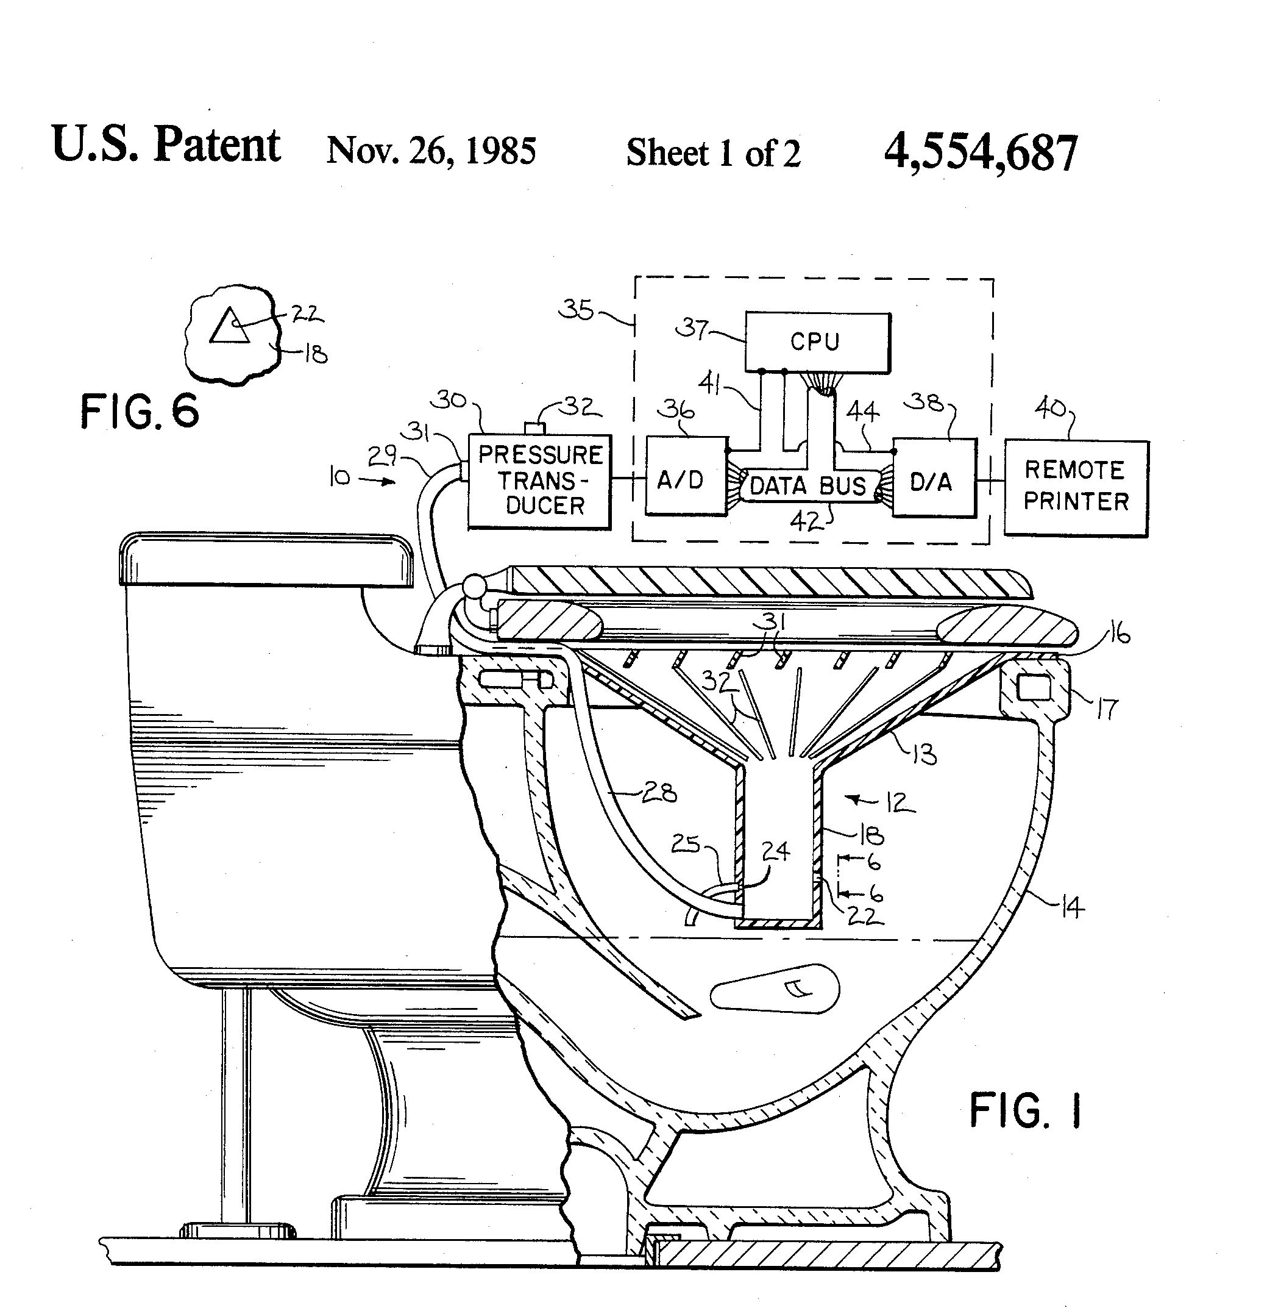
Existing Technologies
Patented Technology
US 4554867 A – Toilet Mounted Urine Flowmeter

Slide 16
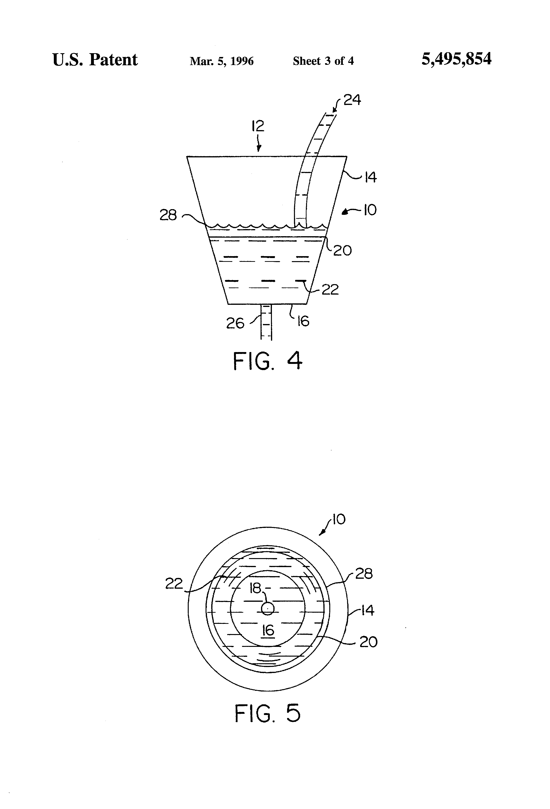
Existing Technologies
Patented Technology
US 4554867 A – Toilet Mounted Urine Flowmeter
US 5495854 A – Self-Testing Device For Measuring Urinary Flow Rates

Slide 17
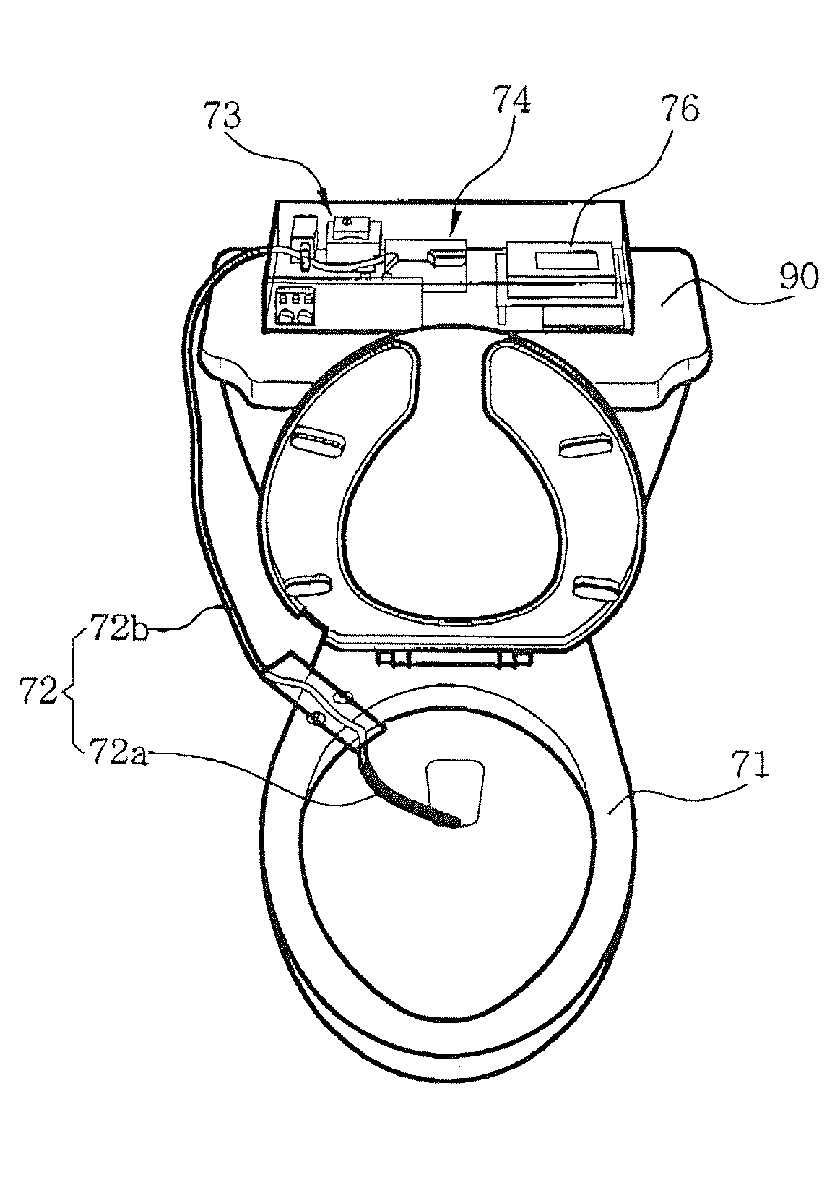
Existing Technologies
Patented Technology
US 4554867 A – Toilet Mounted Urine Flowmeter
US 5495854 A – Self-Testing Device For Measuring Urinary Flow Rates
US 20110265576 A1 – Uroflowmeter attachable to toilet

Slide 18
Need
Creating technology that is
Accurate
Minimal clean up
Minimal maintenance

Slide 19
Project Scope
Create a flow-through uroflow system that gives volume and flow rate of urine in real-time.
Notes:
Explain relationship between volume and flow rate

Slide 20
Design Specifications
Specification | Specific Values
Measurement of flow rate and volume not dependent on contact with urine.
System’s size adaptable to standard European and American toilet sizes | Depth 0.686-0.762 m, Width <0.508 m, Possible urinal adaptation
Larger target area accounting for deviation in stream | Smallest case is 0.25 m²
Water Resistant Machinery | ISO 2281 – suitable for everyday use, splash/rain resistant
Capture volume from 0-1L | Accurate to 3 mL
Capture flow from 0-50 mL/s | Emphasis on 0-5 mL/s Accurate to 0.2 mL/s
Notes:
ISO 2281 – Suitable for everyday use, splash/rain resistent, not submersion. Meant for watches but still okay.

Slide 21
Design Schedule

Slide 22
Team Organization
Group 32
Jordan Nick
Signal Processing, Mechanical Design
Akhil Sundar
Marketing, Industry Research, Vallidation, and Verification
Jodi Small
Computer Science, Group Management

Slide 23
References
Abrams, Paul H., and Roger C.L. Feneley. “The Significance of the Symptoms Associated with Bladder Outflow Obstruction.” Urologia Internationalis 33.1-3 (1978): 171–174. Web. 18 Sept. 2014.
“Adenoma.” Medterms. N.p., n.d. Web. 17 Sept. 2014.
"BladderScan® for Quick Bladder Volume Measurement." Bladder Volume Measurement with BladderScan®. N.p., n.d. Web. 17 Sept. 2014.
"Bladder Outlet Obstruction: MedlinePlus Medical Encyclopedia." U.S National Library of Medicine. U.S. National Library of Medicine, n.d. Web. 12 Sept. 2014.
Carter, Garry L., and Vaughan B. Weeks. “Toilet Mounted Urine Flow Meter.” 26 Nov. 1985. Web. 17 Sept. 2014.
Cha, Eun Jong et al. “Uroflowmeter Attachable to Toilet.” 3 Nov. 2011. Web. 17 Sept. 2014.
Chapple, Christopher R., and Claus G. Roehrborn. “A Shifted Paradigm for the Further Understanding, Evaluation, and Treatment of Lower Urinary Tract Symptoms in Men: Focus on the Bladder.” European Urology 49.4 (2006): 651–659. Web. 17 Sept. 2014.
Currie, Richard J. “Self-Testing Device for Measuring Urinary Flow Rates.” 5 Mar. 1996. Web. 18 Sept. 2014.
“FloRite – Disposable Urine Flow Test Received FDA Registration (#10044145) and Can Be Sold in the USA.” N.p., n.d. Web. 17 Sept. 2014.
"Flowmaster - PC Based Wireless Uroflowmeter." Urology. N.p., n.d. Web. 16 Sept. 2014.
“Lower Urinary Tract Symptoms in Men | Doctor PDF.” Patient.co.uk. N.p., n.d. Web. 18 Sept. 2014.

Slide 24
References
Manieri, C. et al. “The Diagnosis of Bladder Outlet Obstruction in Men by Ultrasound Measurement of Bladder Wall Thickness.” The Journal of Urology 159.3 (1998): 761–765. Print.
Megyeri, J., and J. Varga. “Prostatic Infarction.” International Urology and Nephrology 7.4 (1975): 315–319. Print.
Nguyen, Nam-Trung, and Thai-Quang Troung. “Flow rate measurement in microfluidics using optical sensors.” 1st international conference on sensing technology, Palmerston North. 2005.
Nitti, Victor W. “Pressure Flow Urodynamic Studies: The Gold Standard for Diagnosing Bladder Outlet Obstruction.” Reviews in Urology7.Suppl 6 (2005): S14–S21. Web. 17 Sept. 2014.
Oesterling, Joseph E. “Benign prostatic hyperplasia: a review of its histogenesis and natural history.” The prostate 29 S6 (1996). 67-73.
"Toilet Sizes. Standard Toilet Dimensions." Toilet Sizes. Standard Toilet Dimensions. N.p., n.d. Web. 21 Sept. 2014. <http://www.rempros.com/dimensions/toilet_sizes.html>.
“Uroflowmeter Measures Urine Volume Simply by Using Toilet #DigInfo.” YouTube. YouTube, n. d. Web. 19 Sept. 2014.
"Uroflowmetry: MedlinePlus Medical Encyclopedia." U.S National Library of Medicine. U.S. National Library of Medicine, n.d. Web. 17 Sept. 2014.
Wiest, Peter P., and Hubert G. Fuchs. “Device for Measuring the Urine Flow (uroflow) of Patient.” 5 Jan. 1993. Web. 18 Sept. 2014.

Slide 25
Questions?

